Slide 1
FUNDAMENTALS OF ACCOUNTING FOR NON-ACCOUNTANTS

Slide 2

RAY LAPIZ PANGAN, LPT, MABM-CAR
Part Time Faculty
Address: Moto Norte, Loon, Bohol
Facebook Account: Ray Pangan/Contact No. 09155198647
Work Experience:
Senior High School Teacher
Loon South National High School
Financial Sales Analyst-North America Rebates
Lexmark Research & Development Corp.
Accounting Analyst
Pepsi Cola Product Phils. Incorporated
Internal Auditor
Dueksam, Inc.
Educational Attainment:
Master of Art in Business Management (MABM-CAR)
Mater Dei College
BSED-Qualifying Major Social Studies
University of Bohol
BS in Accountancy
Mater Dei College
Batch 2006

Slide 3
COURSE SYLLABUS PRESENTATION

Slide 4
What is your impression about this subject?
What is your expectation about this subject?

Slide 5
Week 1 Introduction to Accounting
Learning ObjectiveS:
- RECOGNIZE AREAS, BRANCHES, ORGANIZATIONS, ACTIVITIES AND USERS OF ACCOUNTING

Slide 6
Brief History of Accounting
In Venice, as early as November 1494, Luca Pacioli, a Franciscan monk, had published a book which contained the primary principles of Mathematics and incidentally a set of accounting procedures. The title of this book was “Summa de Arithmetica, Geometria, Proportioni et Proportionalita” (Everything about Arithmetic, Geometry, Proportions and Proportionality) which includes, Particularis de Camputis et Scripturis or “Details of Calculation and Recording” which described the doubly-entry system of bookkeeping.

Slide 7
Although Luca Pacioli did not claim that the art of bookkeeping was invented and developed by him, he has been regarded as the father of double-entry system stating that the purpose of bookkeeping was “to give the trader without delay the information as to his assets and liabilities”. Pacioli also advised the closing of books and the computation of periodic profit. He said, “It is always good to close the book each year, specially if you are in a partnership with others. Frequent accounting makes for long friendship”.
Luca Pacioli is the father of accounting.

Slide 8
Accountancy in the Philippines
1700s
Public accounting practices
1923
March 17, 1923, the accounting profession was formally organized through RA 3105
Board of Accountancy (BOA) was created and vested with the authority to issue certificates o qualified applicants.
43 registered accountants
1929
In November 1929, Philippine Institute of Certified Public Accounts (PICPA) was founded.

Slide 9
WHAT IS ACCOUNTING?

Slide 10
Definitions of Accounting
The Accounting Standards Council (ASC) in its old Statement of Financial Accounting Standards (SFAS) No. 1 defines accounting as follows:
“It is a service activity. Its function is to provide quantitative information, primarily financial in nature, about economic entities, that is intended to be useful in making economic decisions.”

Slide 11
Definitions of Accounting
2. The American Institute of Certified Public Accounts (AICPA) defines accounting as follows:
“It is an art of recording, classifying and summarizing in a significant manner and in terms of money, transactions and events which are in part at least of a financial character and interpreting the results thereof.” – widely accepted definition

Slide 12
Definitions of Accounting
3. The American Accounting Association (AAA) define accounting as follows:
“It is the process of identifying, measuring and communicating economic information to permit informed judgments and decisions by users of the information.”

Slide 13
What is the Basic Purpose of Accounting?

Slide 14
We can say that the purpose of accounting is to provide financial information to users that they can make informed judgement and better decision.
Users of Financial Information
1. Owners/Investors – they are concerned with financial information that has a particular bearing on their investment. They would like to know if the business is profitable or not.
2. Management – financial information can be made as a basis in determining the effectiveness and efficiency of management. Profits, for example, may indicate the effectiveness of the marketing people in achieving sales targets.

Slide 15
Users of Financial Information
3. Employees – employees are concerned whether or not their employer has the capacity to provide them competitive remuneration, benefits and opportunities.
4. Creditors – banks and financial institutions require businesses to submit financial statements when applying for loan so that they will be able to assess capability to pay obligations.
5. Government Agencies – Governments have regulatory powers over businesses. The Bureau of Internal Revenue(BIR), for example, needs financial statements to assess taxes to be collected from businesses.

Slide 16
The Basic Financial Statements
Income Statement – This is currently known as the Statement of Financial Operations, or Statement of Comprehensive Income. This practically shows the results of operations of the business for a period of time. As a statement, it showcases the profit/loss equation which states that
Where: Revenues represent the amount receive or collectible from the sale of merchandise. Example: the rendering of services(e.g. barbershop), the use of entity’s resources (e.g. building for rent) or sale of assets other than products(e.g. sales of used cars)
Expenses represent the necessary disbursement or obligations in operating a business. Example: Selling Expenses, Administrative Expenses, Income Tax Expenses, Other Expenses.
Revenue – Expenses = Net Income/Net Loss

Slide 17
2. Balance Sheet – currently known as Statement of Financial Position shows the financial condition of a business as of a given period of time. As a statement, it showcases what is referred to as the Basic Accounting Equation, which states that
Where : Assets are the economic resources of the company from which future benefits are expected to flow to the entity. Example: Cash, Account Receivable, Property, Plant & Equipment, Intangible Asset.
Liabilities are economic obligations of a business which are expected to result to a future outflow of resources. Example: Accounts Payable, Loans Payable, Income Taxes Payable, Notes Payable, Wages Payable.
Capital represents the interest of the owners in the business. Capital is also referred to as owner’s equity. Example: Stockholders’ Equity, Retained Earnings,
Assets = Liabilities + Capital

Slide 18
3. Statement of Changes in Equity – is a statement that presents the changes in the capital account. In the case of sole-proprietorships, there are at least four major events that would affect the capital account, and these are as follows:
Additional Investment – happens when the owner invests more assets to the business. In this case, capital(or equity) increases.
Withdrawals/Drawing – happens when the owner gets assets from the business for personal use. For example, when the owner will withdraw cash from the business to spend for his own, this will have an effect of decreasing his capital in the business.
Income from operations – when the business earns net income, capital of the owner will increase.
Loss from operations – this happens when the expenses of the business exceeds its revenues.

Slide 19
4. Statement of Cash Flows – is a financial statement dedicated to cash. Cash, as an asset, plays a critical function in business because transactions normally start of with cash and ends in it. Thus, the statement of cash flows monitors all the inflows(receipts) and outflows (disbursements) of the business with the intention of computing the cash balance at the end.

Slide 20
The Five Basic Accounting Values
The discussion on income statement and balance sheet above reveals the five basic accounting values. These are assets (economic resources), liabilities (economic obligations), capital (owner’s equity), revenue (sales of goods or services) and expenses (disbursements necessary in earning the revenue).

Slide 21
Computations. In each of the given items, compute for the missing (?) figures.
Part 1. Basic Accounting Equation
 | Asset | Liability | Capital
1 | 100,000 | 40,000 | ?
2 | 55, 000 | ? | 20, 000
3 | ? | 80,000 | 40,000
4 | 68,500 | ? | 22, 300
5 | 79, 560 | 34, 480 | ?

Slide 22
Part 2. Revenue/Expense Equation
 | Revenue | Expense | Net Income/(Loss)
1 | 100,000 | 62,500 | ?
2 | 55, 000 | ? | (20,000)
3 | ? | 98, 520 | 39, 560
4 | 152, 390 | ? | 97, 420
5 | 78, 650 | 128, 550 | ?

Slide 23
Exercise 1.1
Computations. In each of the given items, compute for the missing (?) figures.
Part 1. Basic Accounting Equation (5 points)
 | Asset | Liability | Capital
1 | 2, 350, 000 | 650,000 | ?
2 | 155, 000 | ? | 25, 000
3 | ? | 300, 345. 55 | 450, 000
4 | 750, 250 | ? | 325, 000
5 | 825, 000 | 255, 000 | ?

Slide 24
Part 2. Revenue/Expense Equation (5 points)
 | Revenue | Expense | Net Income/(Loss)
1 | 150,000 | 325, 000 | ?
2 | 1, 550, 000 | ? | (550,000)
3 | ? | 108, 520 | 69, 500
4 | 355, 450 | ? | 250, 350
5 | 88, 350 | 135, 225 | ?

Slide 25
Exercise 1.2
Computations. Solve for the required amounts in each of the given problem. (5 points each)
1. Debid’s Saloon had many customers on July 2, 2018, a Monday. The total money received by the cashier from customers during that day amounted to P29, 640.00. The cashier paid P6,000 of salaries for the service personnel during that day and consumed approximately P2,800 in light and water, as well as supplies. If these are the only expenses for the day, how much net income/loss did Debid’s Salon earn?

Slide 26
2. Bebe, the owner of Mang Kinasal received a total of P125, 268 from the cashier of her store. This represents the sales for the day after deducting P32, 400 of expenses. How much was the total revenue for the day?
3. Danny, owner of Damgo Sari Sari Store, would like to sell his whole business to his sister, Dreams on June 31, 2018. As of that date, the total assets of the store amounted to P3, 250, 650. Danny, however, has a loan at that bank amounting to P2, 000, 000 on that day. If you are Danny and would like to sell to Dreams the store of its net worth, how much would you be willing to receive?

Slide 27
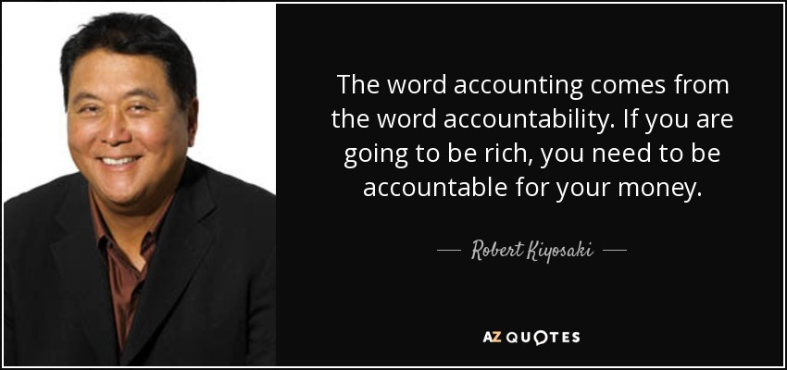

Slide 28


